Slide 1
RCoB Travel Pre-Approval Procedure

Slide 2
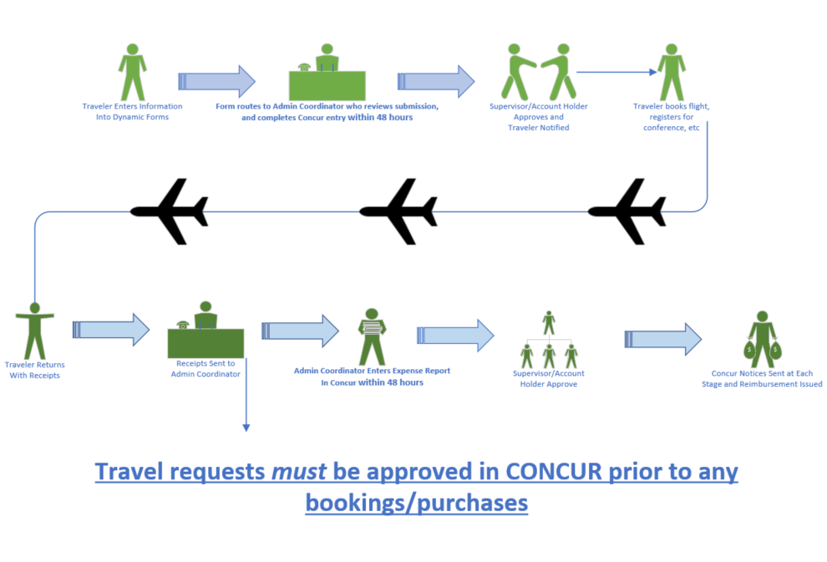

Slide 3
Remember
Concur Pre-Approval Required
All travel requests must be approved in concur before travel arrangements are made. An email from a Director, Chair, or Staff member does not mean your travel is approved!
Concur Is An Estimate
What you enter on the dynamic form is what staff will use to complete your request in Concur so please be as accurate as possible – however, Concur is a pre-approval tool with estimated expenses, so there is no need to submit additional requests if airline ticket prices change, etc.
Plan Ahead
Please allow a minimum of 3 weeks before anticipated dates of travel for concur processing.
Notes:
You will incur out of pocket expenses that will not be reimbursed if you do not have pre-approval prior to booking your travel arrangements.

Slide 4
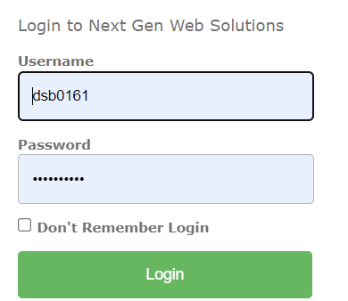
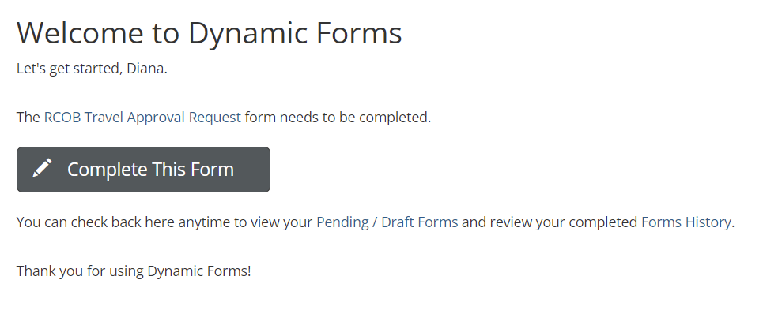
https://cob.unt.edu/travel-request
1
2
3
Notes:
1. The form requires Single Sign On so you will need to be connected to the VPN if you are off campus.
2. Once you log in, you’ll be taken to the welcome screen within the Dynamic Form. You’ll click on Complete This Form and then
3. You will select your department representative.

Slide 5
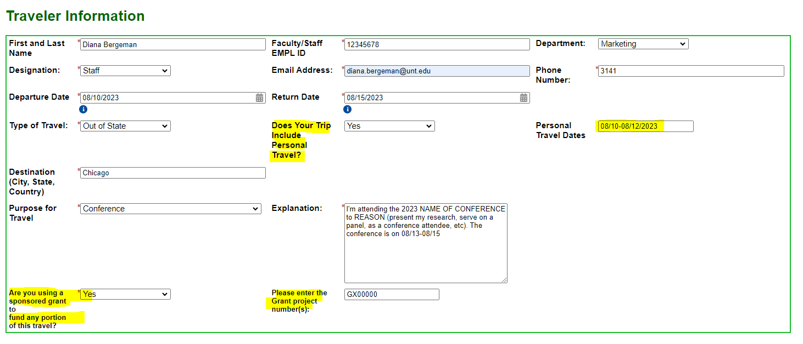
Double Check Your Information
Please pay special attention to the travel dates – you will use the actual dates of travel, not the ‘event’ dates.
More is MORE
The more information you provide in the explanation field, the better.
Notes:
Enter the information for each field – asterisk next to each field indicates the field is required.
In the explanation field, you’ll put a brief summary of your proposed travel: for example - attend 2022 Business Conference. If there is anything out of the ordinary with your travel, you’ll put it here as well. For example, departing the night before for conference start on DATE at 8:00 am.

Slide 6
Travel Segments
Flights
You will select whether you need a flight.
If you need a flight, you will select whether or not you will book in concur, or on your own outside of concur.
If you elect to book in concur, you will be asked to provide carrier, departure times, etc.
Notes:
Please note – selecting that you will book your flight in concur and putting the detailed information DOES NOT actually book your flight. Additional steps will be necessary once your concur request is approved. Further directions on how to book the flight will be shown at the end of this presentation.

Slide 7
Travel Segments
Hotel Arrangements
Choose whether or not you will be staying at a hotel.
Please be sure to include estimated taxes!

Slide 8
Travel Segments
Rental Car
You will select whether or not you need a rental car.
Remember – based on your choices, some boxes will not show
Mileage
If you plan on driving yourself to your conference destination, you will select NO for flight and NO for Rental Car.
You CAN claim mileage to/from the airport.
Notes:
Different boxes will pop open based on the responses you choose.
Mileage costs cannot exceed the cost of a plane ticket.
When claiming mileage, you will not be reimbursed for fuel costs.

Slide 9
Travel Segments
Ground Transportation
You will enter any estimated ground transportation costs here, including uber, lyft, train, etc.
Parking
You will enter any estimated costs for parking here.

Slide 10
Travel Segments
Registration
You will enter the conference registration amount here.
Other Expenses
Meals
You can enter estimated toll expenses here.
You can enter estimated fuel expenses here if getting a rental car.
RCoB reimburses at approved per diem rates for any meal NOT provided by the conference.
Receipts for food are not required!
Notes:
Different boxes will pop open based on the responses you choose.
If a meal is provided by the conference but you elect not to eat it, you will not be reimbursed for any meal in place of the provided one.

Slide 11
Travel Segments
Miscellaneous and Approximate Total
This text box is free form so you can enter any relevant information that you think will help with the concur entry.
If you have any specific funding requirements, for example you wish to use research funding, you can enter that information here.
Notes:
The system will generate your estimated expenses, before per diem.

Slide 12
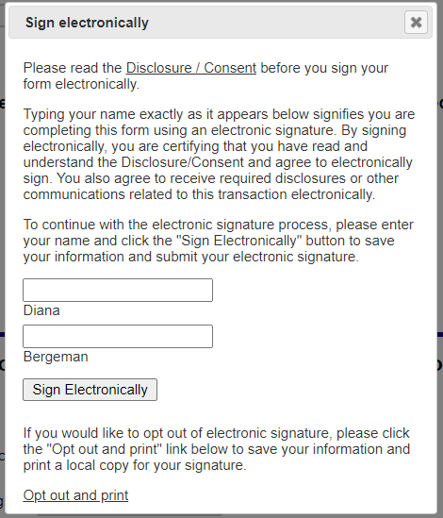
Uploads and Submission

Slide 13
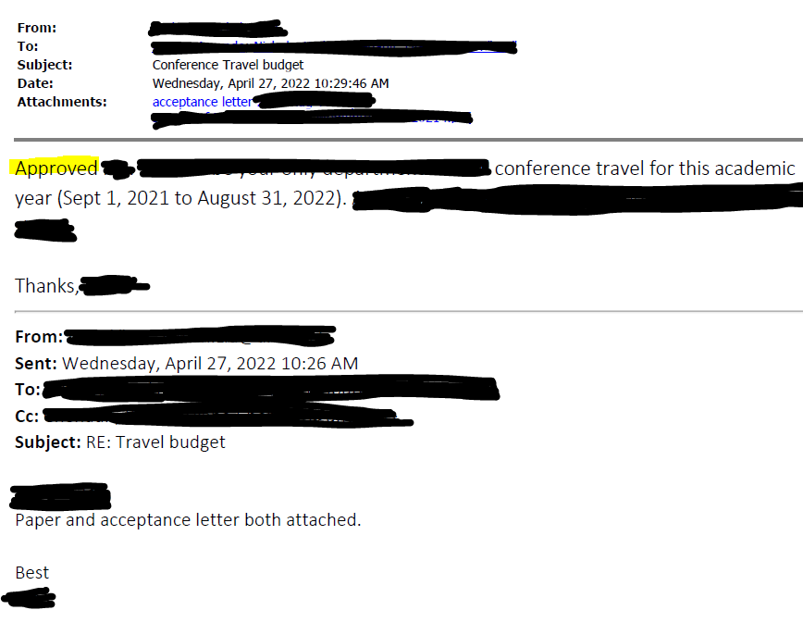
Upload Samples
Notes:
You will also need to provide the conference agenda, if available.

Slide 14
Assigning a Delegate

Slide 15
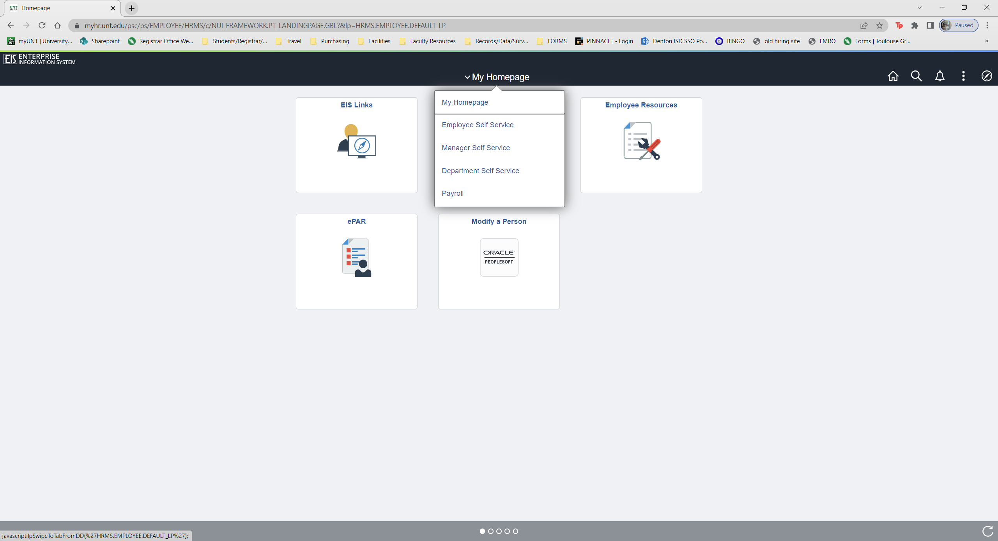
Assigning Delegates
Sign in to concur and make me a delegate for requests, travel, and expense.
Go to my.untsystem.edu

Slide 16
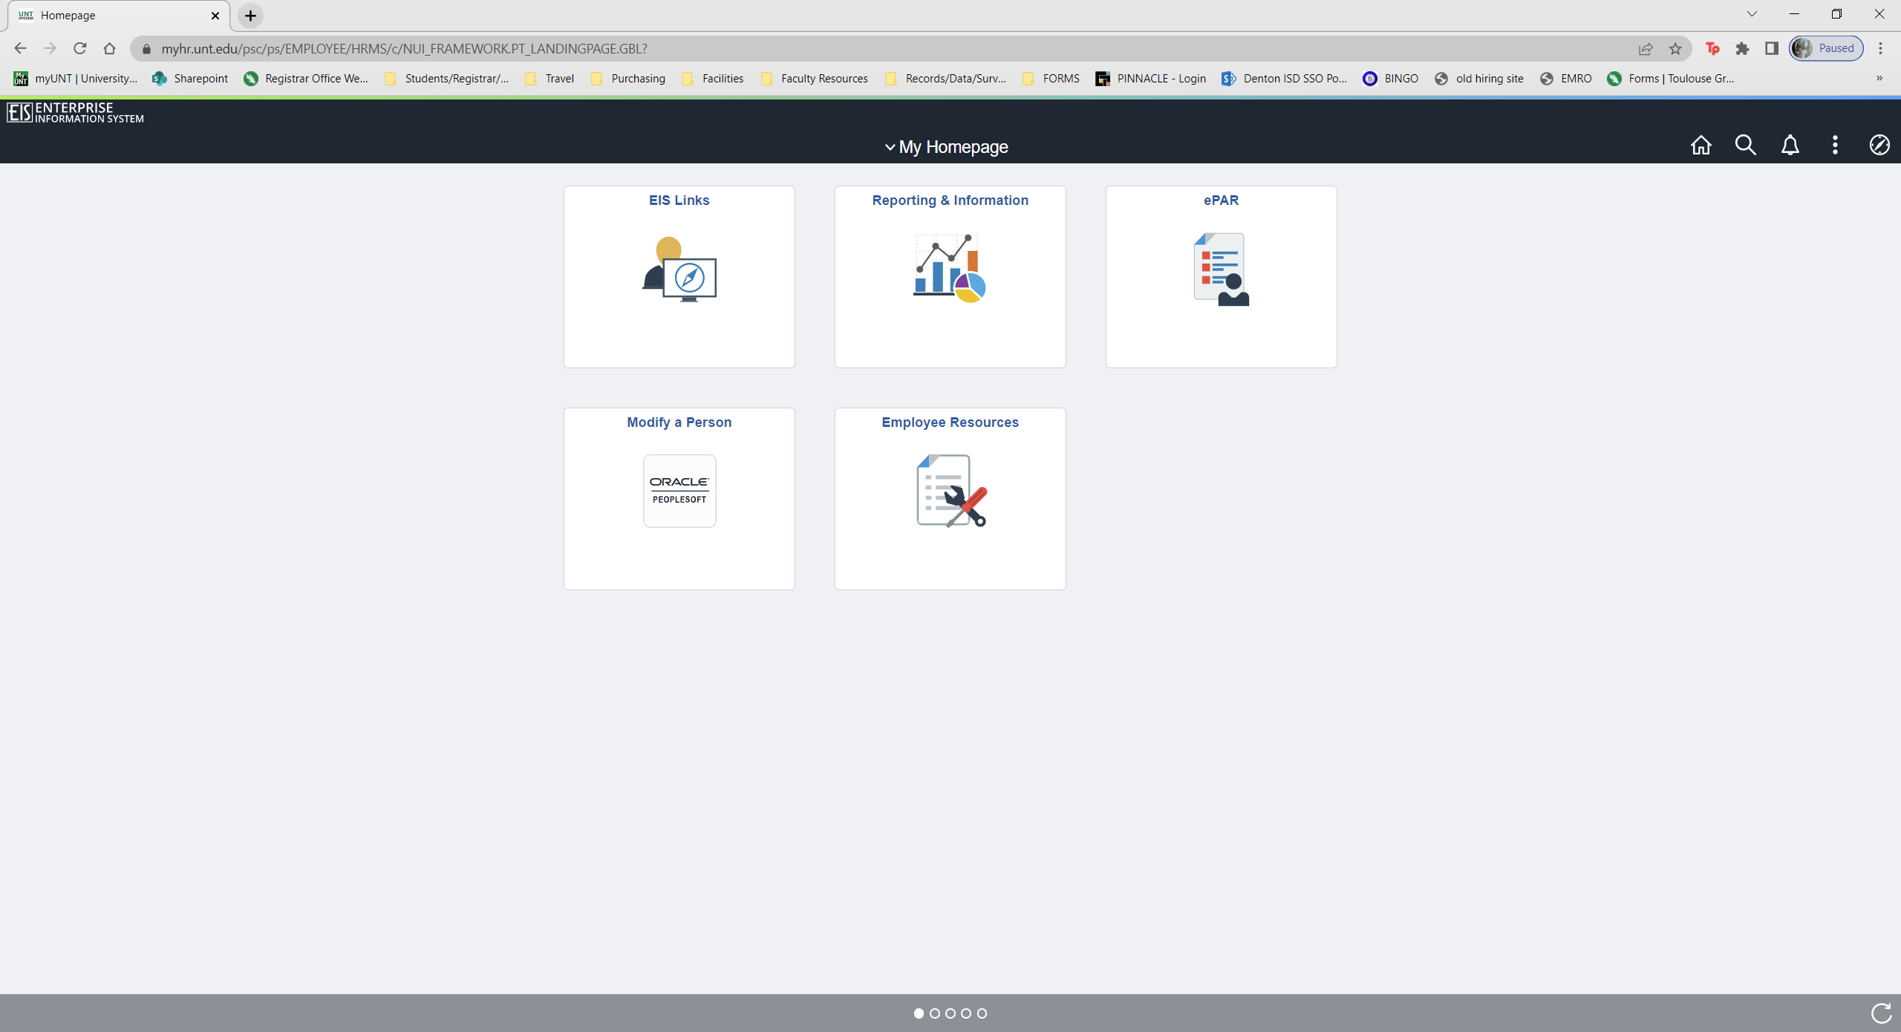

Slide 17
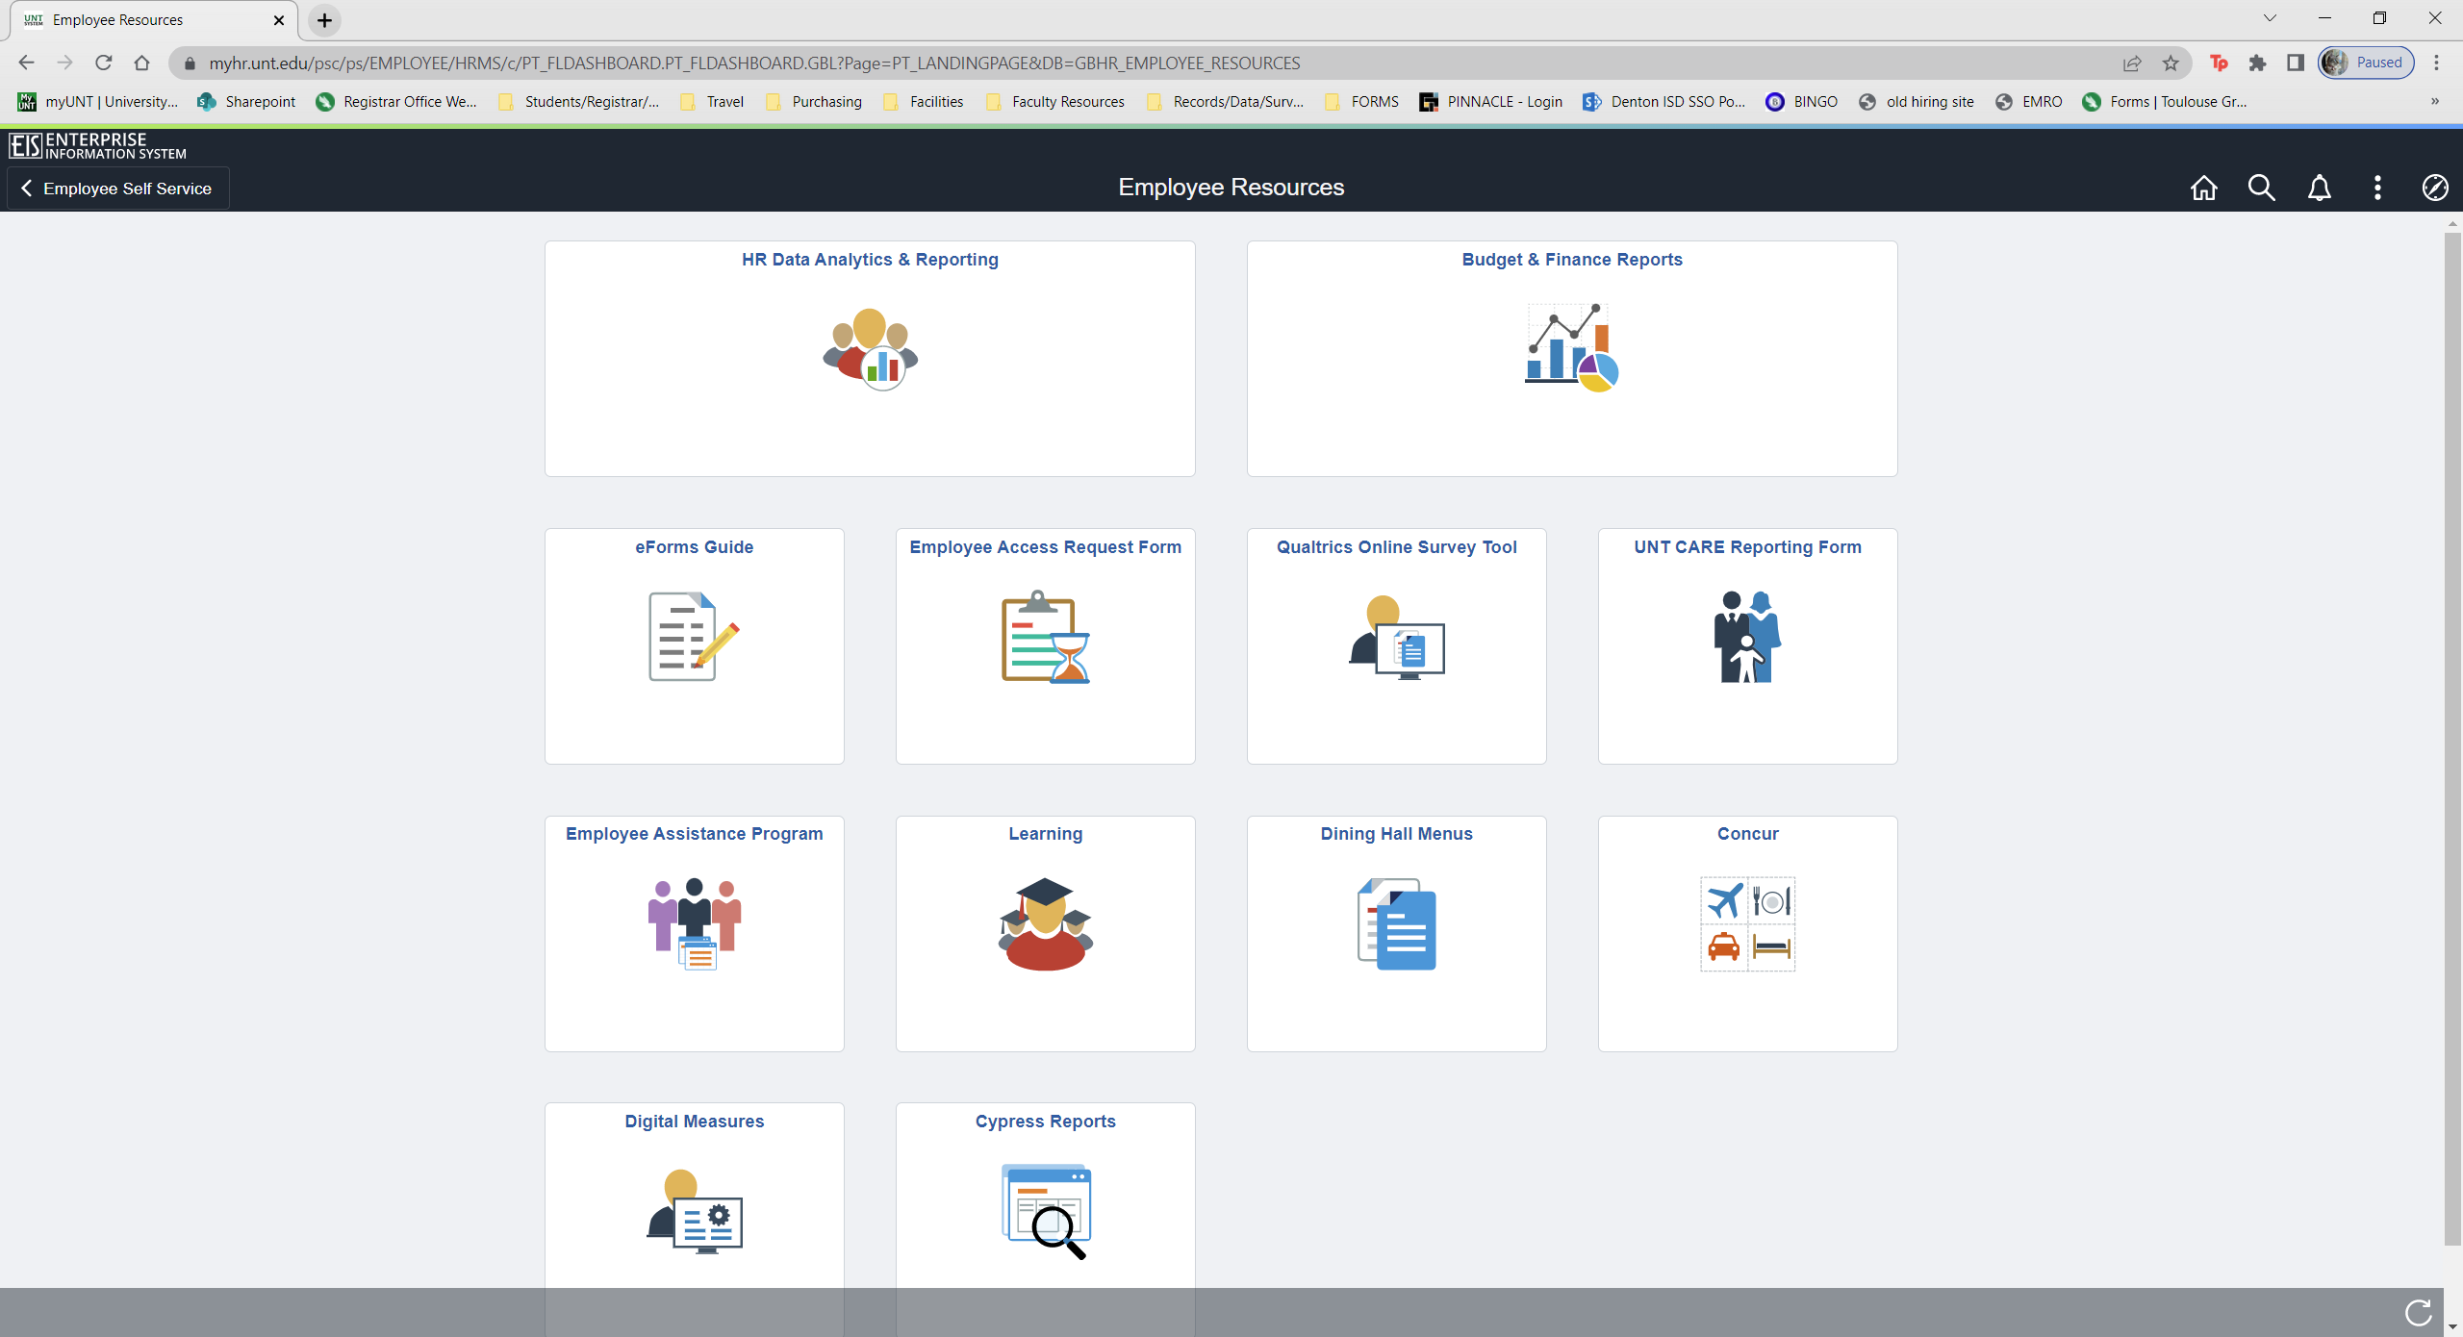
Click on Concur

Slide 18
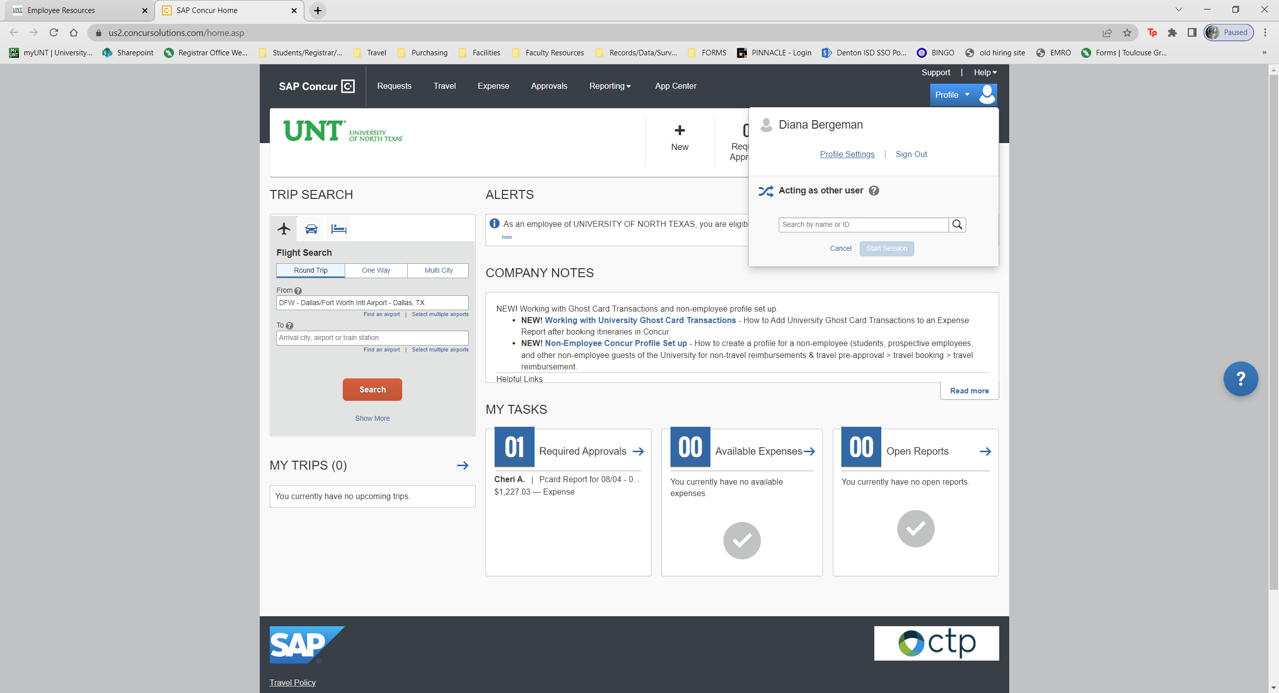
Click on Profile, then Profile Settings.

Slide 19
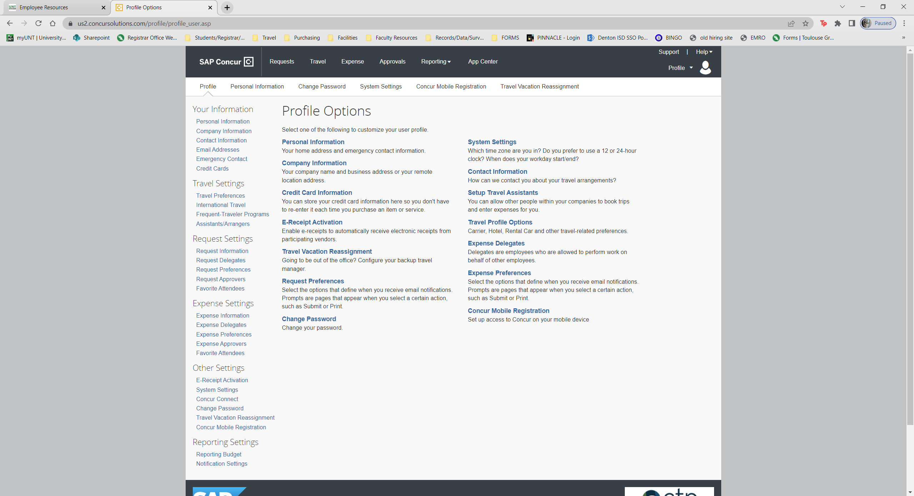
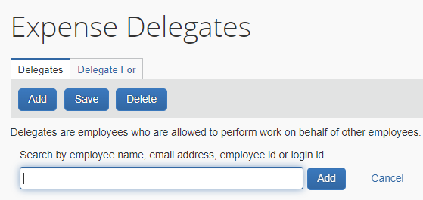
Click on the links on the left side of the page to set delegates.
Click Add
Search by dsb0161 or my name.
Dsb0161

Slide 20
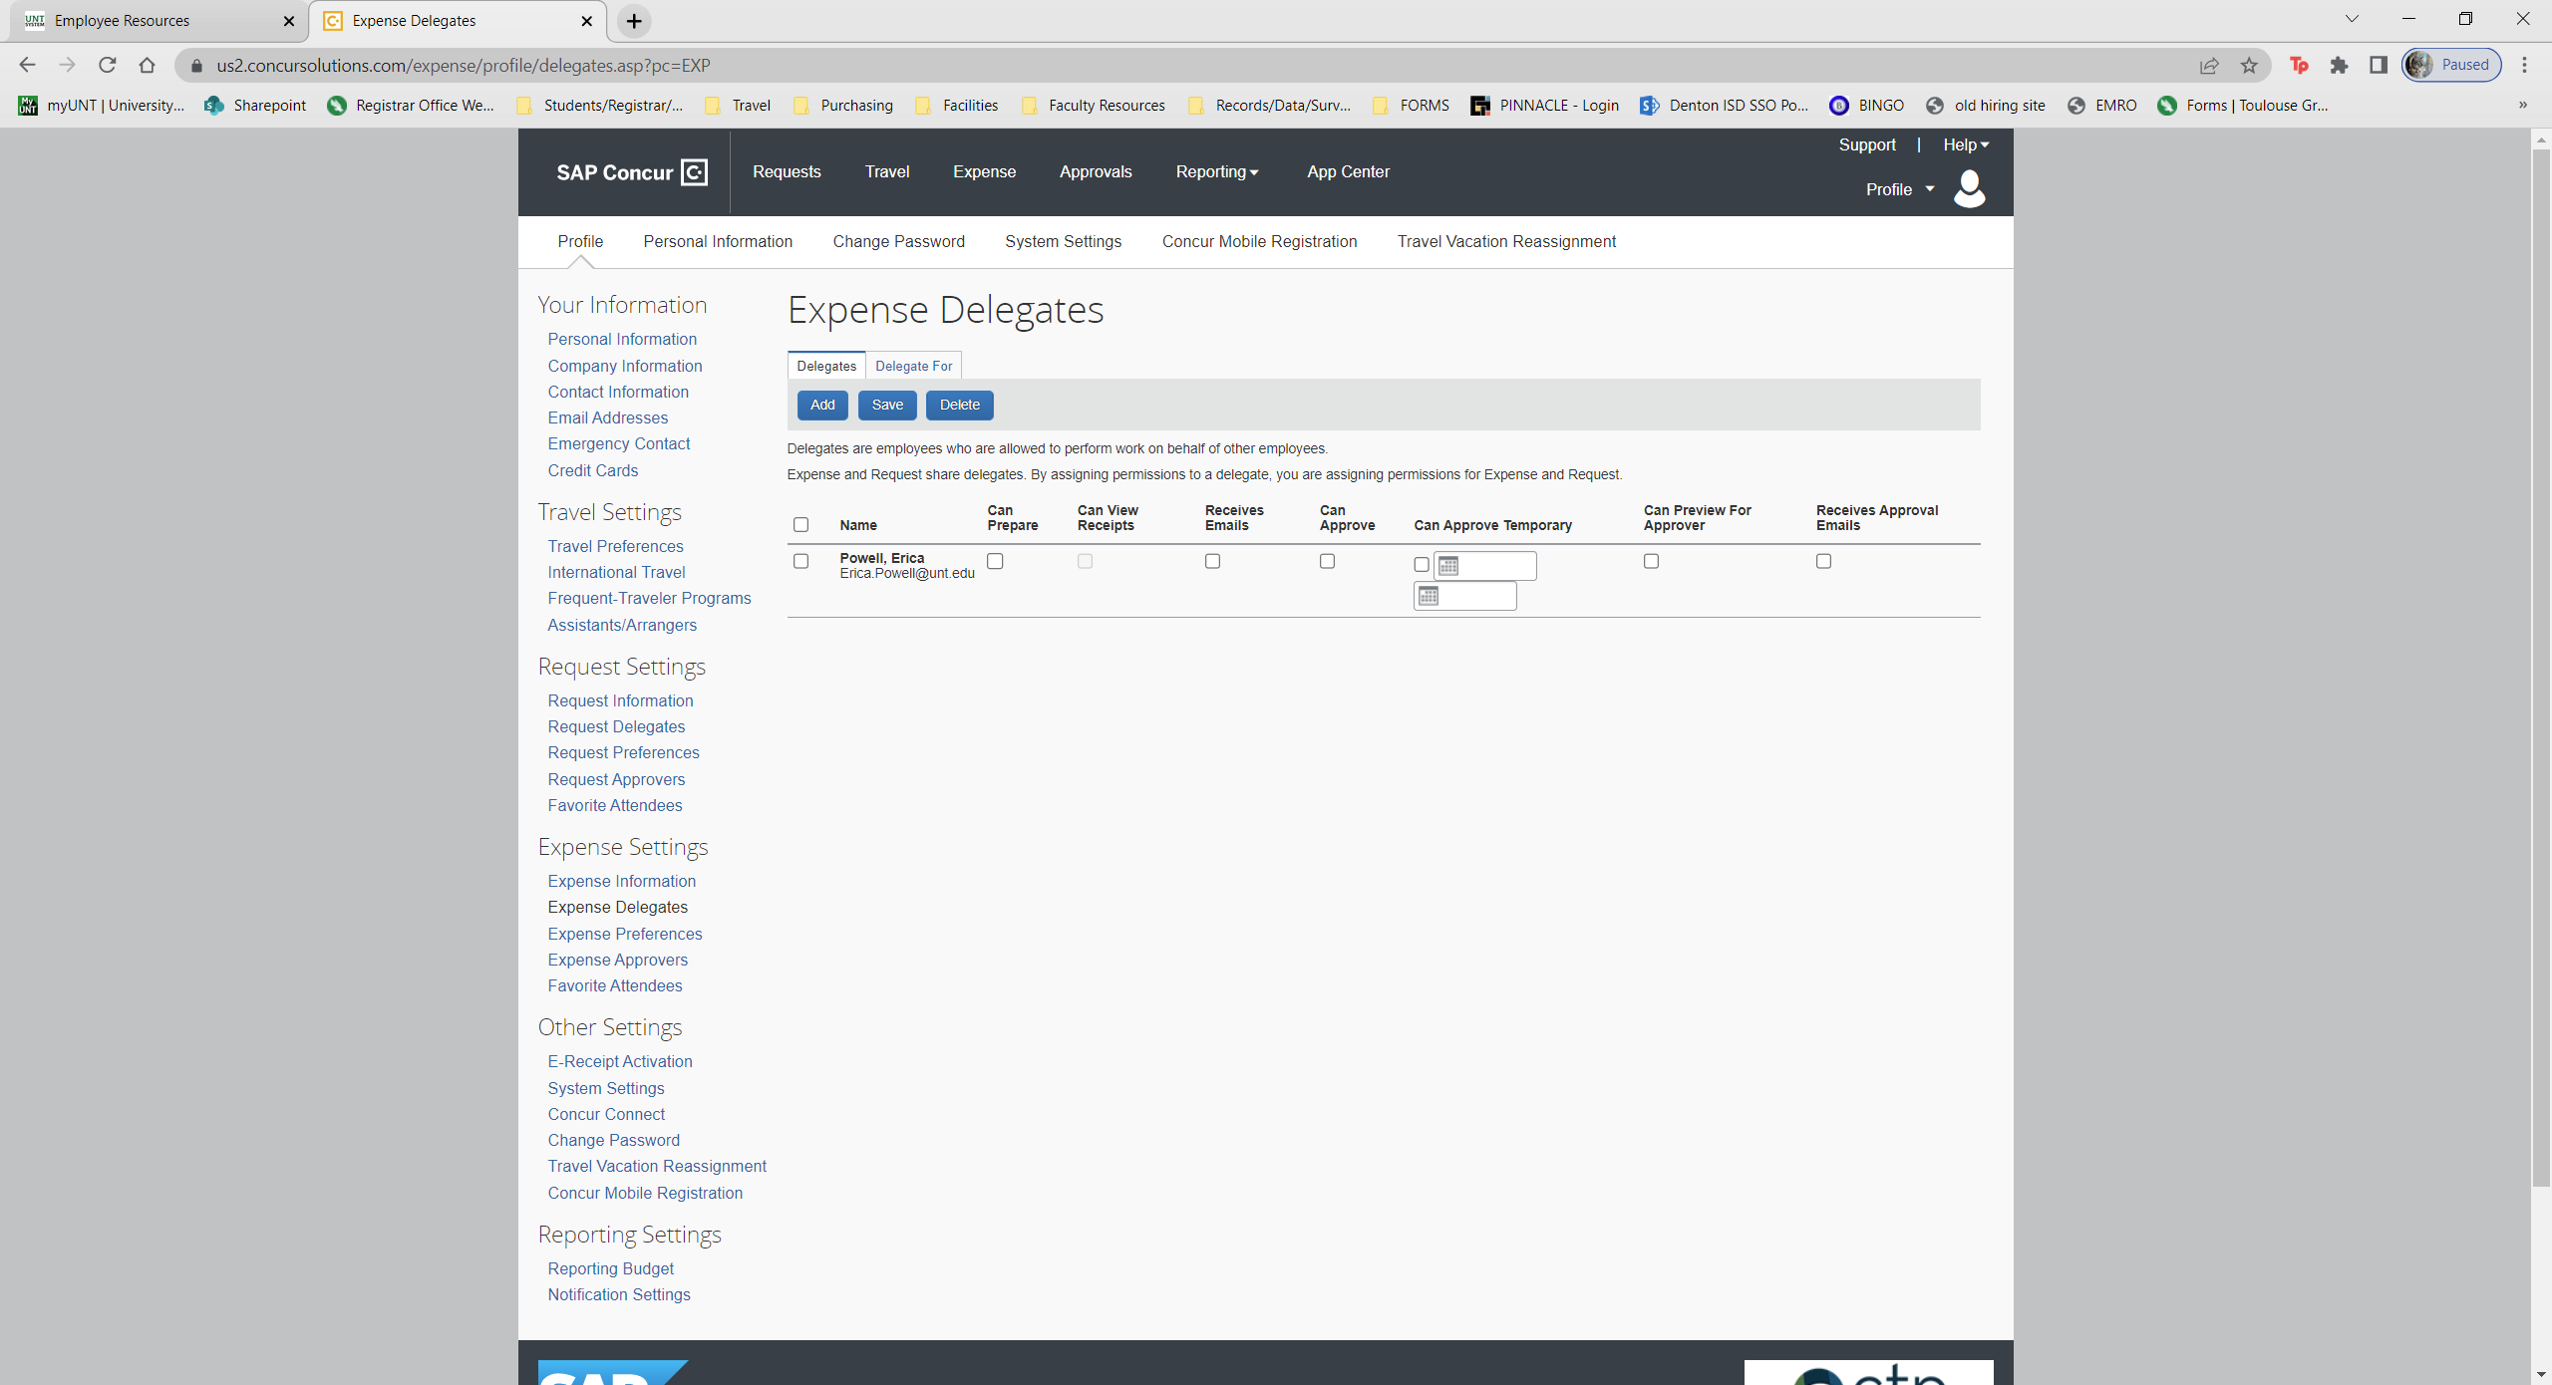
Once I’m in the list, checkmark the following:
Can Prepare
Can View Receipts
Repeat the same process for Request and Expense.

Slide 21
Submitting a Request

Slide 22
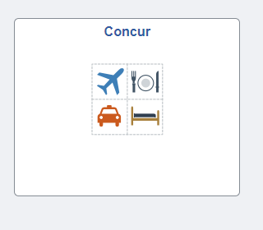
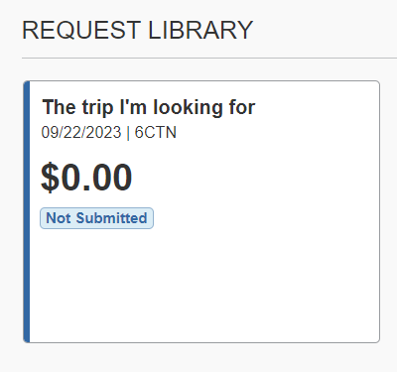
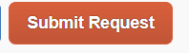
Submitting your expense report for reimbursement
Log in to my.untsystem.edu and use the drop down to get to Employee Self Service
Click on the Employee Resources tile
Click on the Concur Tile
Click on Requests
Click on the trip tile
Click Submit Request

Slide 23
Submitting an Expense Report

Slide 24
Submitting your expense report for reimbursement
Log in to my.untsystem.edu and use the drop down to get to Employee Self Service
Click on the Employee Resources tile
Click on the Concur Tile
Click on Expense
Click on the appropriate tile
Click Submit

Slide 25
Booking Your Flight In Concur

Slide 26
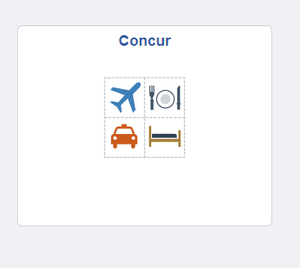
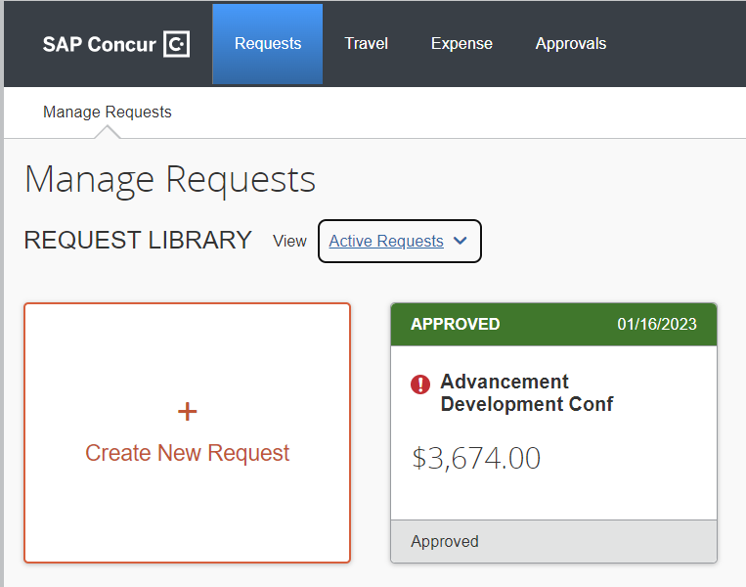
Once your travel request has been approved in Concur, if you have elected to book in Concur, you can log in and book your ticket.
My.untsystem.edu
Book your Flight
Flight
Review Itinerary
Employee Resources
Concur
Select Request from the top then open the correct approved request
Status should say ‘Pending Online Booking’
Select ‘Book’ or select the blue tab under the request number.
Select your flight
DO NOT PUT IT ON HOLD
Review itinerary
Proceed with booking and finalize your flight.
1
If you experience any problems, please don’t hesitate to reach out to your designated department travel representative or contact the Dean’s Office!
2

