Slide 1
View this slide deck to learn more about mentoring with PLP!

Slide 2
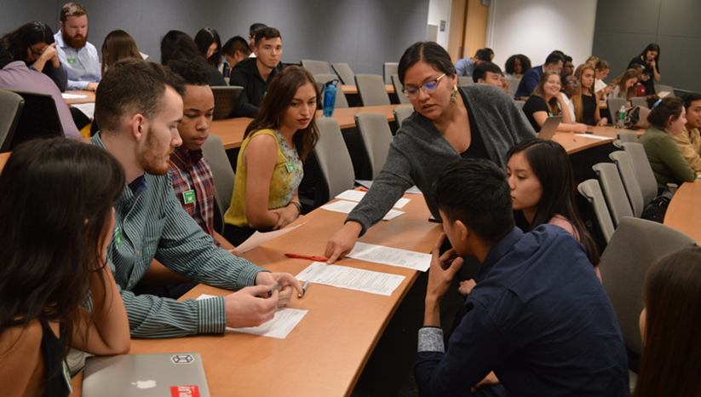
Mentoring with the Professional Leadership Program
This slide deck covers:
PLP Overview
Student Selection & Experience
PLP Core Competencies
Mentoring Overview & Selection
Mentor Matching Process
Mentor Benefits
FAQ

Slide 3
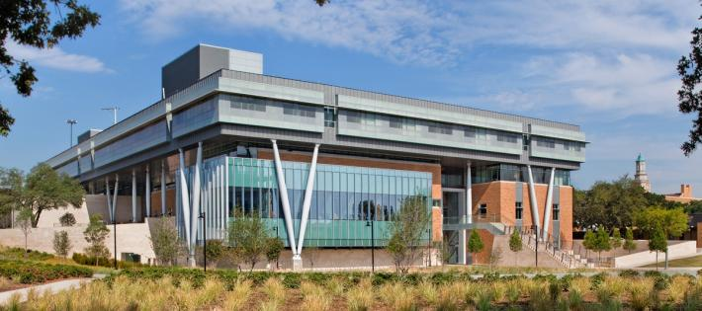
Professional Leadership Program
CULTIVATING SERVANT LEADERSHIP IN UNT STUDENTS THROUGH WEEKLY meetings & CONNECTION WITH INDUSTRY MENTORS

Slide 4
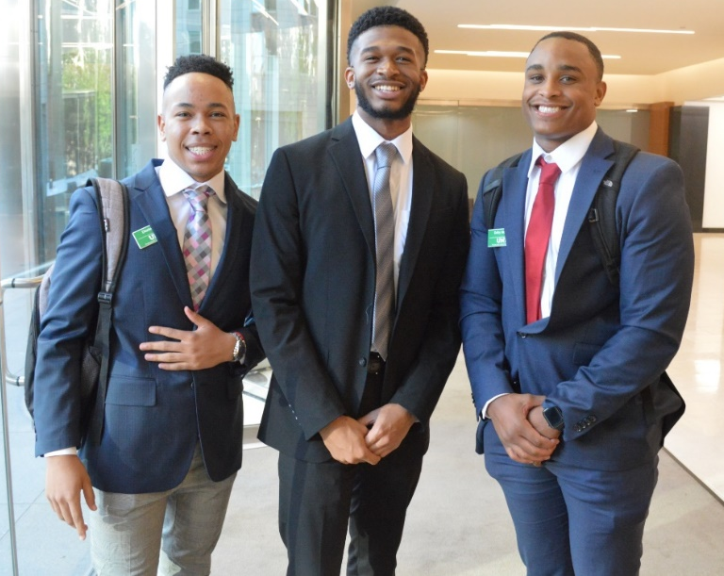
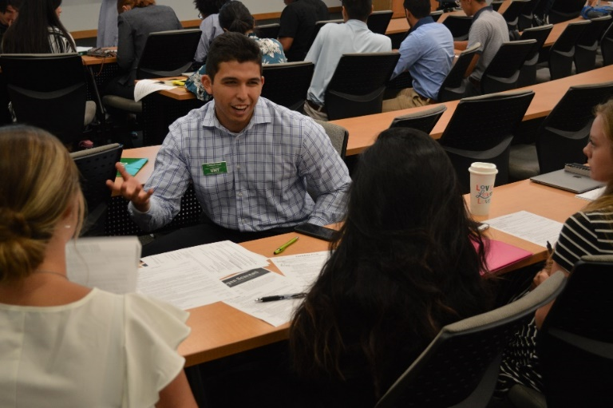
PLP Student Selection
Application Requirements
Cumulative GPA: 3.25+
Sophomore, junior, senior, or graduate student
Coachable mentality
Presently enrolled at UNT
Application Process
Apply online
In-person interview
Selection
New member orientation to accept membership
Full academic year commitment
Notes:
Who our students are and how they are selected for the program

Slide 5
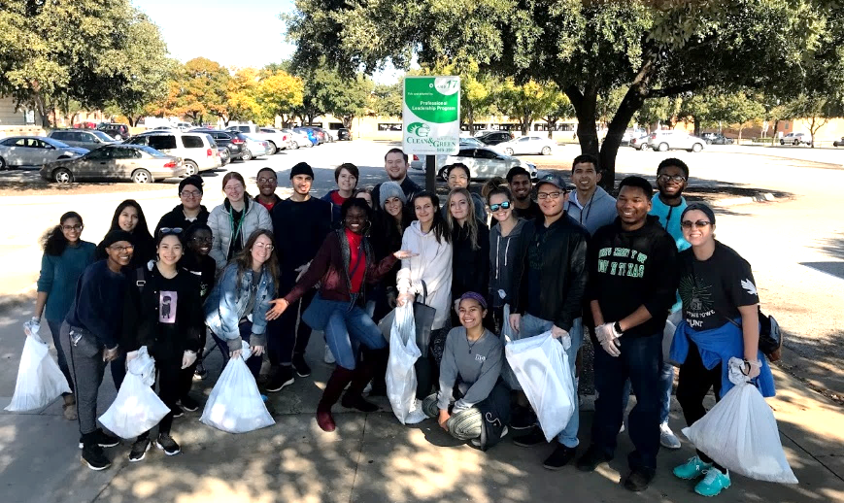
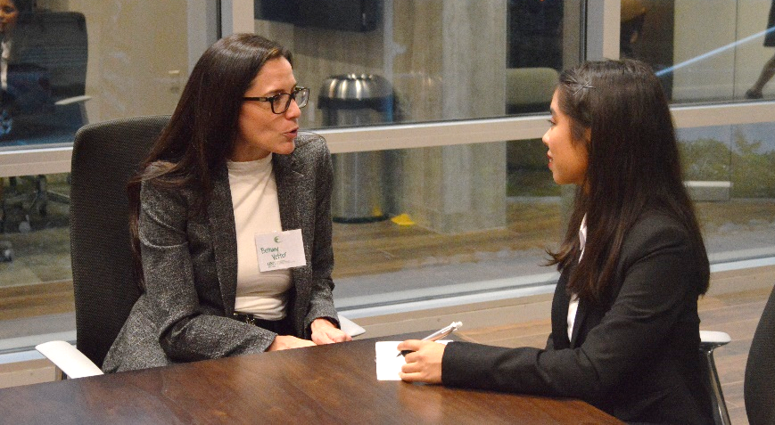
PLP Student Member Experience
Weekly Meetings – Wednesdays at 5:00 p.m.
Speaker/Facilitator – Subject Matter Experts
Cluster Time – Student Director-Led
Case Study/Presentation Competition
Mentoring Relationship
Meet monthly at minimum
1/1 Goal Sessions
With Student Director (peer mentor)
Business After Hours
Twice per semester on Wednesday nights
Volunteering Commitment
Social Events
Invitations to campus & corporate partner opportunities
Notes:
The program from the student point-of-view

Slide 6
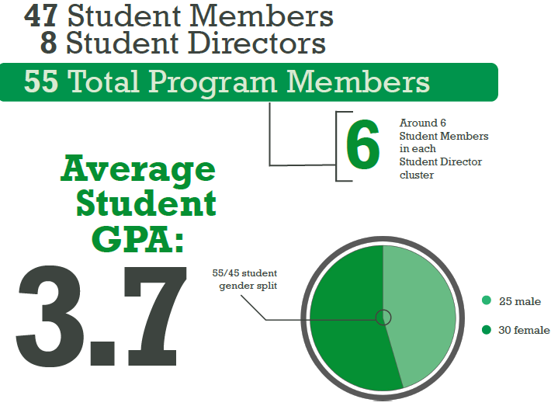
2020 – 2021 PLP Class
Notes:
Our class demographics change every year, but we always have great variety among our students.

Slide 8
PLP Core Competencies PLP curriculum is focused on delivering content to our student members that is connected to one of these 7 core competencies.
Stewardship How actions drive personal and program performance
Servant Leadership What more can I do
Diversity & Inclusion
Current with different values & perspectives
Communication
Professional messaging through all mediums
Teamwork Trust and Accountability
Problem Solving
Do decisions make economic sense
Ethical Practice
Integrity at all times
Notes:
PLP is focused on delivering content to our student members that are related back to one of these 7 core competencies.

Slide 9
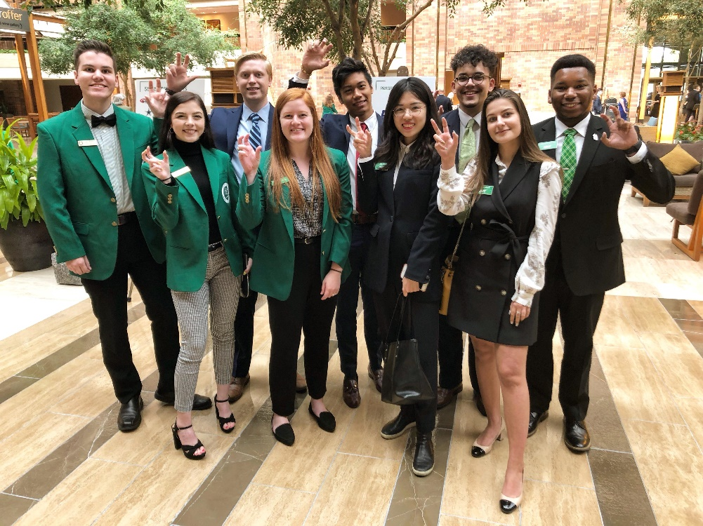
Mentoring Overview
Paired 1-on-1 with a PLP student in your area of expertise
Monthly meeting with mentee
Focused on required development topics (provided through a PLP mentoring guide)
Opportunity to attend PLP workshops & networking events
Personal satisfaction from investing in the next generation of leaders
Notes:
What is mentoring with PLP?

Slide 10
Mentoring Criteria
5 years of professional experience
Referral by a PLP community member (mentor, alumni, etc.) or Screening call with PLP staff
Servant leadership mentality
Willingness to incorporate mentee into business aspects of organization
No previous felony convictions or listed on National Sex Offender Registry
Notes:
Criteria to be a mentor

Slide 11
Mentoring Commitment
Commitment to 1 academic year, meet once every month
Paired in summer
Mentoring from August – May
Consistency in mentoring relationship
Mentors are encouraged to attend all PLP events, as able
Examples:
Mentor Training (summer)
Summer Mixer
Fall Kick-Off (early September)
Business After Hours (twice per semester)
Open PLP Meetings
Willingness to connect with entire PLP community
Contact information is distributed for connection among mentors and students

Slide 12
How to Become a Mentor
Visit https://cob.unt.edu/plp/mentoring and review all information
Complete online application/mentor profile: PLP.XINSPIRE.COM
Conduct screening call with PLP staff, as needed
You’re eligible for matching!
Questions? Contact PLP@UNT.EDU

Slide 13
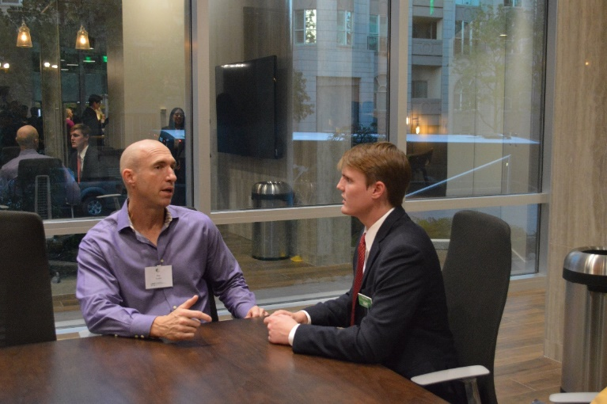
Matching Process
Matching takes place during the summer
Algorithm-based
Hand-verified
Focused on Industry/Major matches
Possibility of not being matched
Dependent upon student class makeup & number of mentor candidates

Slide 14
Xinspire
Software platform used to collect applications & match mentoring pairs
If matched:
Xinspire becomes you main connection portal to PLP: resources, event RSVPs, platform to track your relationship, etc.
Your application becomes a “profile”
Sensitive information is hidden
PLP.XINSPIRE.COM
Notes:
Xinspire becomes the mentor’s main connection portal to PLP, if they are matched with a student.

Slide 15
Mentor Benefits
Invitation to 5+ business networking events per year
Invitation to participate in PLP’s Mentor Certification
Access to professional development through open invitation to weekly PLP meetings & online resources
Connection with mentors from dozens of companies
Opportunity to serve on PLP Board of Directors

Slide 16
Companies represented by our mentors:
AAR
ACAP Healthworks
ALY
Andrews Distributing
Bell Flight
BKD
Business Centric Technology
CCS Fundraising
Ciera Bank
Communities Foundation of Texas
Cornerstone Wealth Strategies
East West Bank
Ericsson
eXp Realty
Fidelity Investments
Frito-Lay, Inc
Garza Group Custom Home and Real Estate Development
GES
GM Financial
Holmes Murphy & Assocaites
iLink
Kaye/Bassman International Corp.
Landmark Properties-The Retreat at Denton
Lennox International, Inc.
Lockheed Martin
Merrill Lynch Global Wealth & Investment Management
Olicana Enterprises Inc.
PACCAR Inc.
Pensivia
PepsiCo
Peterbilt
RealPage Inc.
Revision Skincare
Ryan, LLC
Salesforce, Inc.
Sally Beauty Holdings, Inc
Seven13 Enterprises Inc.
SJS Communications
Sports in Action LLC
Swissflex
Tech Mahindra Americas, Inc
The ELM Advisory Group
Triadh
TriMark Strategic
University of North Texas
University of North Texas System
Verizon
Vizient, Inc.
WESCO Aircraft
West Monroe Partners
Notes:
Industry Partners – Mentors from these companies for the 2020-2021
class year

Slide 17
Corporate Sponsors 2020 - 2021

Slide 18
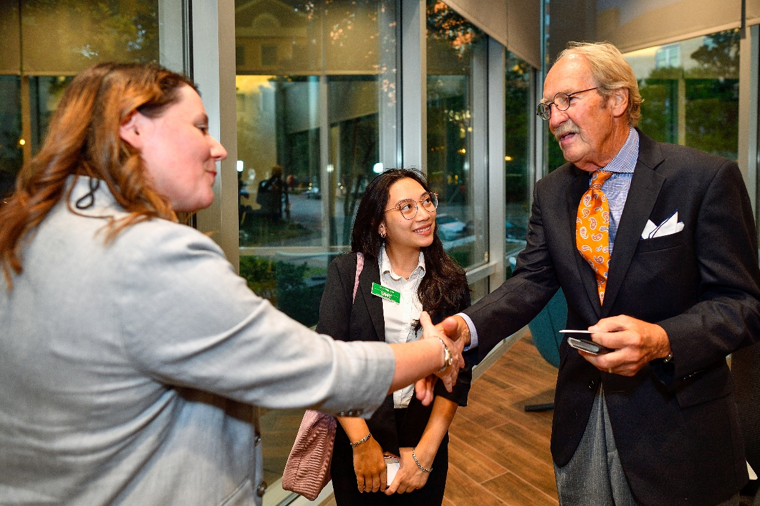
Sponsorship Opportunities
Summer Mixer
Student Director Retreat
Business After Hours events
Fall Kick-Off
Mentor Training
Apparel Sponsor
Technology Sponsor
+ Endless Possibilities!

Slide 19
Frequently Asked Questions

Slide 20
Do I have to attend the weekly PLP meetings?
You are welcome to join us for “open” meetings, but it is not an expectation.
Open meeting dates/information are posted on Xinspire at the beginning of each semester
Notes:
Meetings are on Wednesdays from 5:00 – 7:00

Slide 21
I can’t get my mentee a job. Is that okay?
PLP is not a career placement program
It is not your job to get them a job
Your role as a mentor is to share experiences & help them form their own path

Slide 22
Denton is really far! Do I have to meet my mentee there?
During typical semesters, we encourage you to meet with your mentee in person. During COVID circumstances, you can utilize Zoom, Skype, FaceTime, etc.
Please indicate your willingness to travel for in-person meetings on the application. We will pair students without a car based on your travel preference.
Notes:
We will pair mentees who do not have a vehicle with mentors who are willing to travel to Denton. If you are not willing/able to travel to Denton for every meeting, we will be sure to pair you with a student who has their own vehicle.

Slide 23
I’ve never mentored before. What do I do?
We provide resources to help you navigate through the mentoring experience
The Mentor Certification through PLP provides a checklist of topics and discussions to have each semester
We will provide you with mentor training tips and ideas to connect with your mentee
We will connect you with other new and returning mentors in the PLP community
Notes:
We will have training opportunities for new & returning mentors during the summer to set you up for success.
Additionally, our Mentor Certification curriculum gives guidance on the exact skills & conversations to cover with your student.

Slide 24
Other Questions?
Contact PLP@UNT.EDU
or one of our staff members.
View staff contact information here:
https://cob.unt.edu/plp/people
Notes:
View our staff contact information here: https://cob.unt.edu/plp/people

Slide 25
PLP.XINSPIRE.COM
Apply by June 1, 2021

