Slide 1
Manual Credit Granting

Slide 2
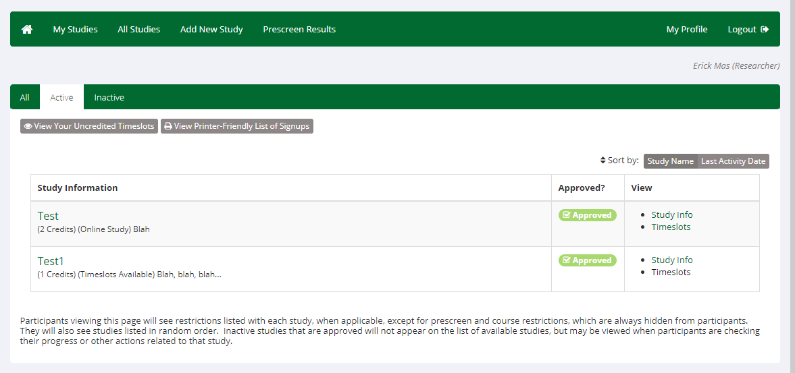
1
2
3

Slide 3
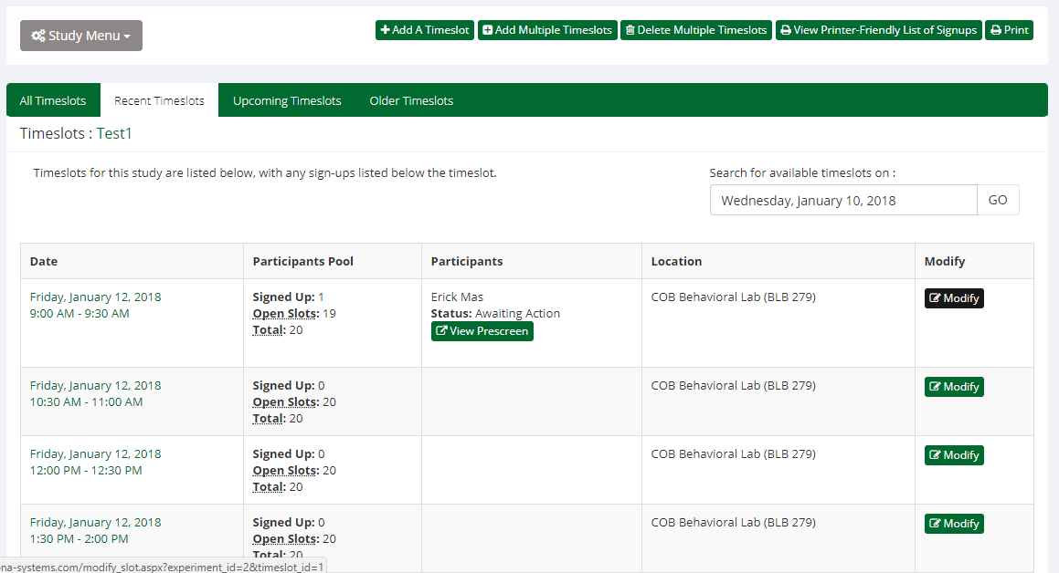

Slide 4
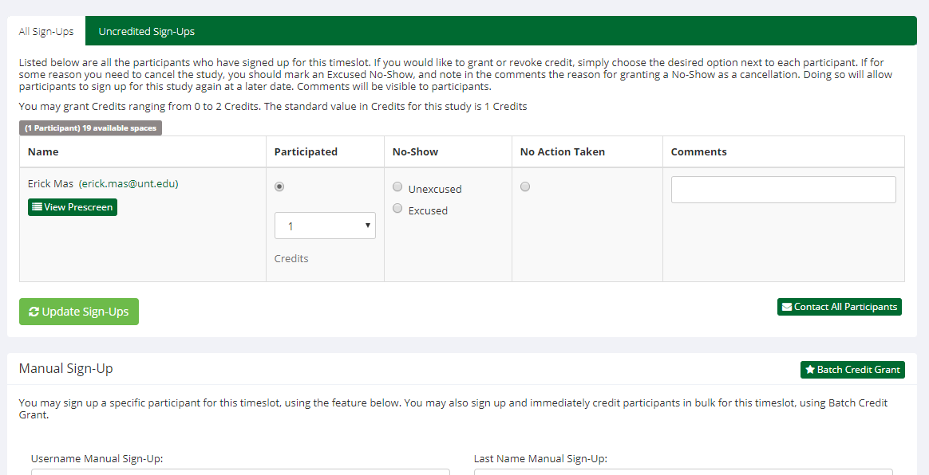
1
2

Slide 5
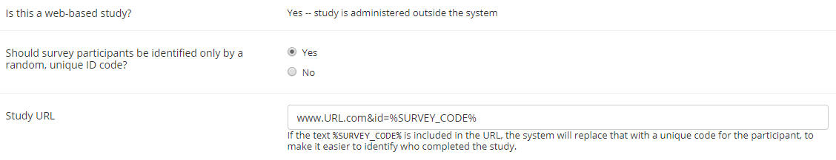
Online studies allow for auto-approval
Click Here for information on how to automatically grant credit for online studies.

