Slide 1
Posting Studies to SONA

Slide 2
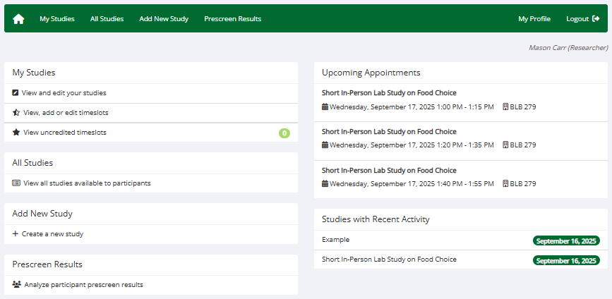

Slide 3
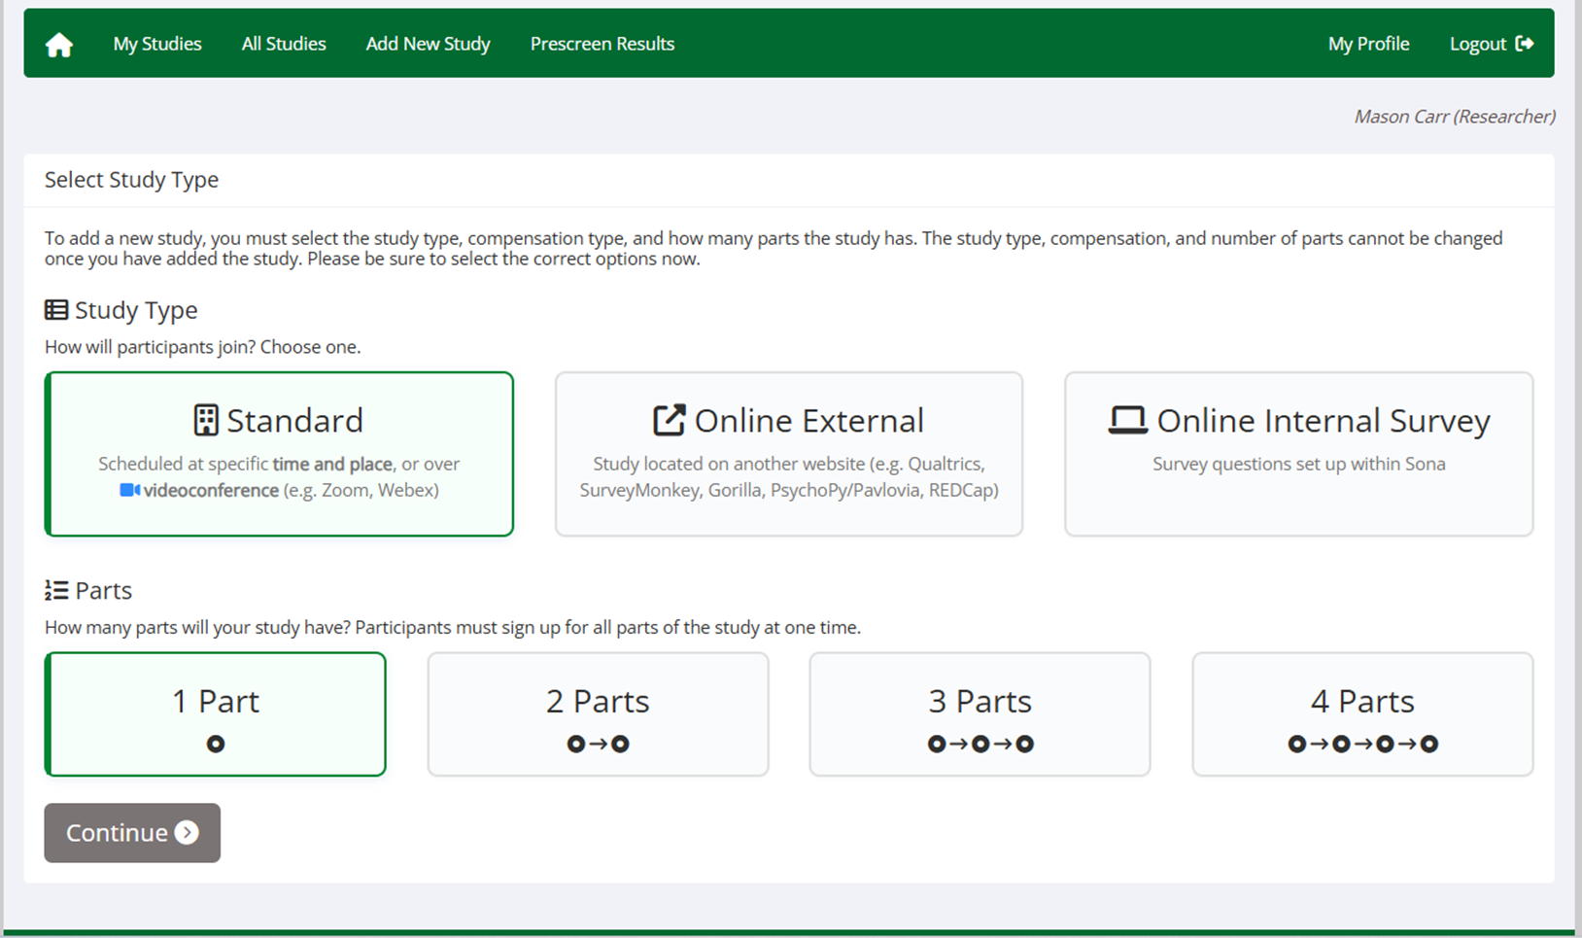

Please note that lab studies also require a request for the physical lab space.

Slide 4
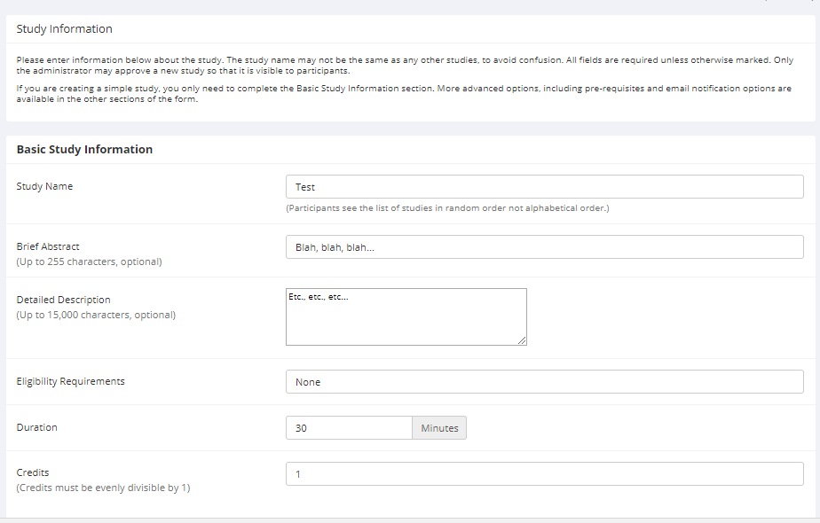

Slide 5
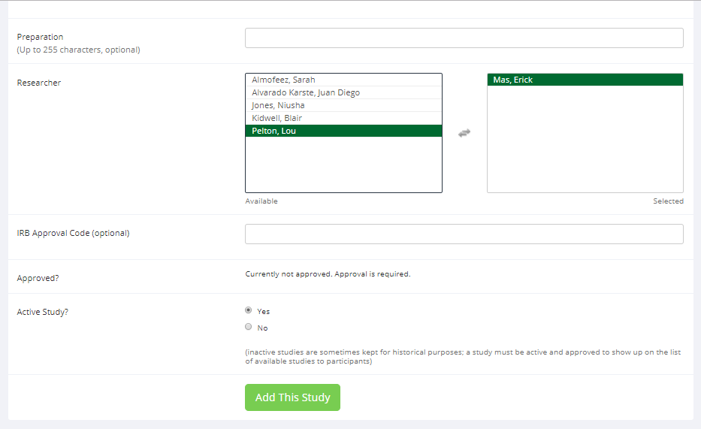

Slide 6
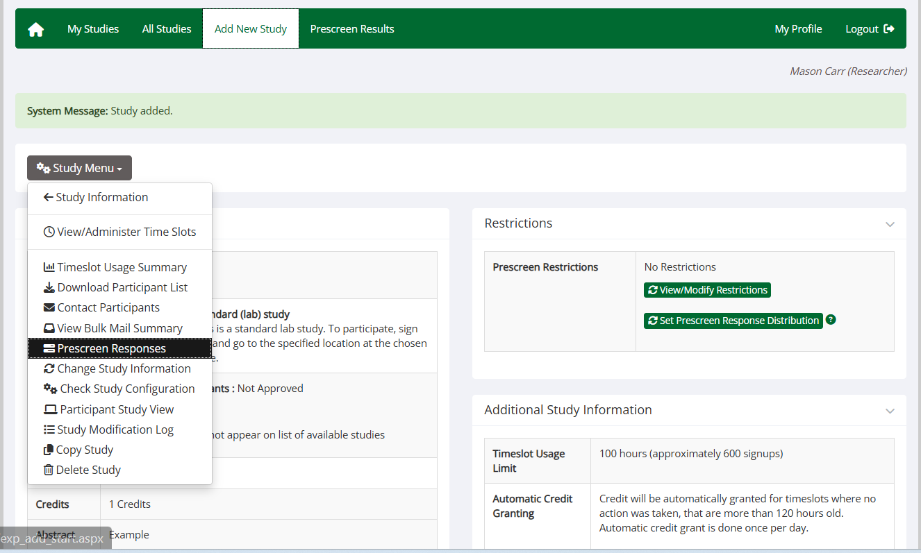
Lab studies must also add timeslots by clicking ‘View/Administer Timeslots’

Slide 7
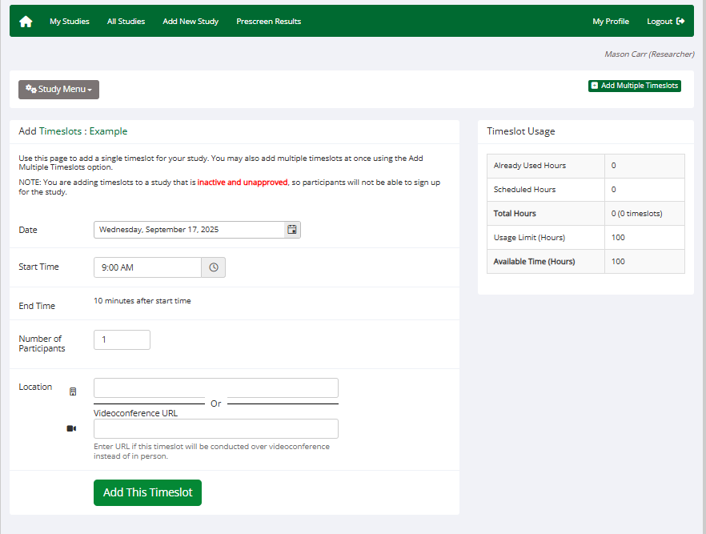
Add a single timeslot

Slide 8
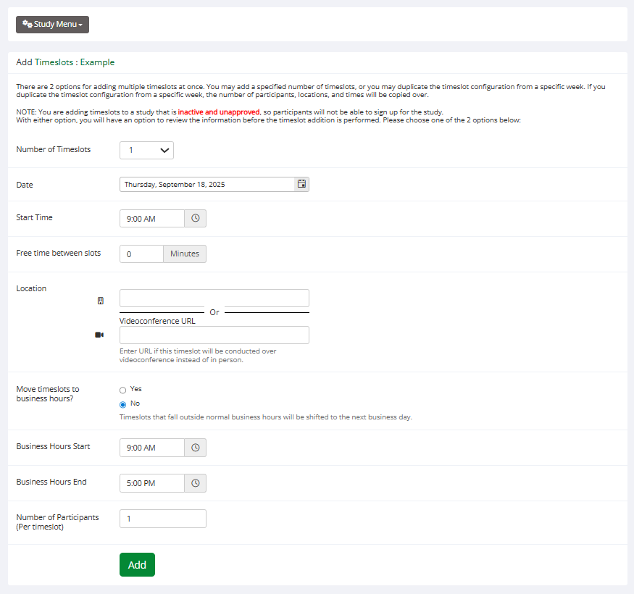
Add multiple timeslots at one time

Slide 9
Notes on Timeslots
-The duration of a timeslot is automatically determined by the duration of the study.
-Each timeslot must realistically allow for completion of the study the specified number of participants. (Maximum of 16 limited by lab space)
After adding timeslots, please complete the Behavioral Lab Request Form to request use of the BLB279 Lab space. Once approved, your request will be booked on the BLB279 Behavioral Lab Outlook calendar.

Slide 10
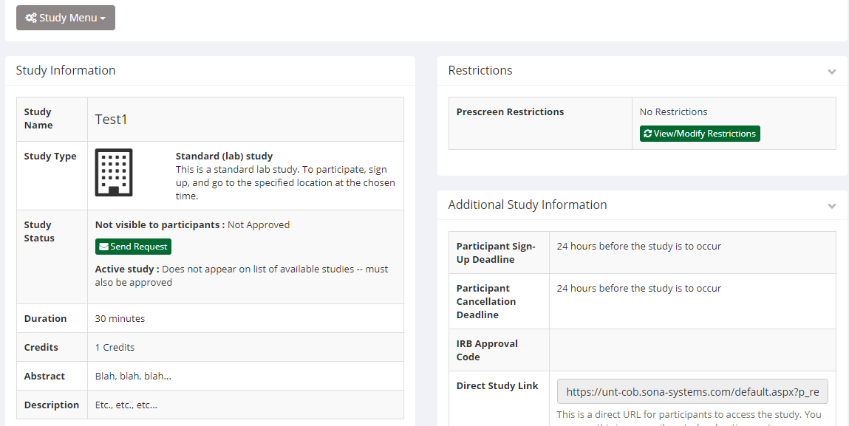
Click this button to send Approval Request to Admin for quicker approval

